Slide 1
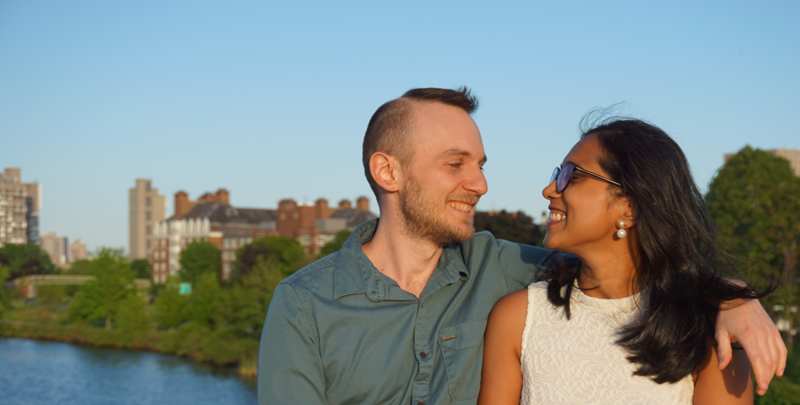
Tanvi & Ilia
are getting married!
Oct 11-12, 2022 (New Delhi, India)
Oct 18, 2022 (Beit Oren, Israel)
Invitations coming soon!

